Slide 1
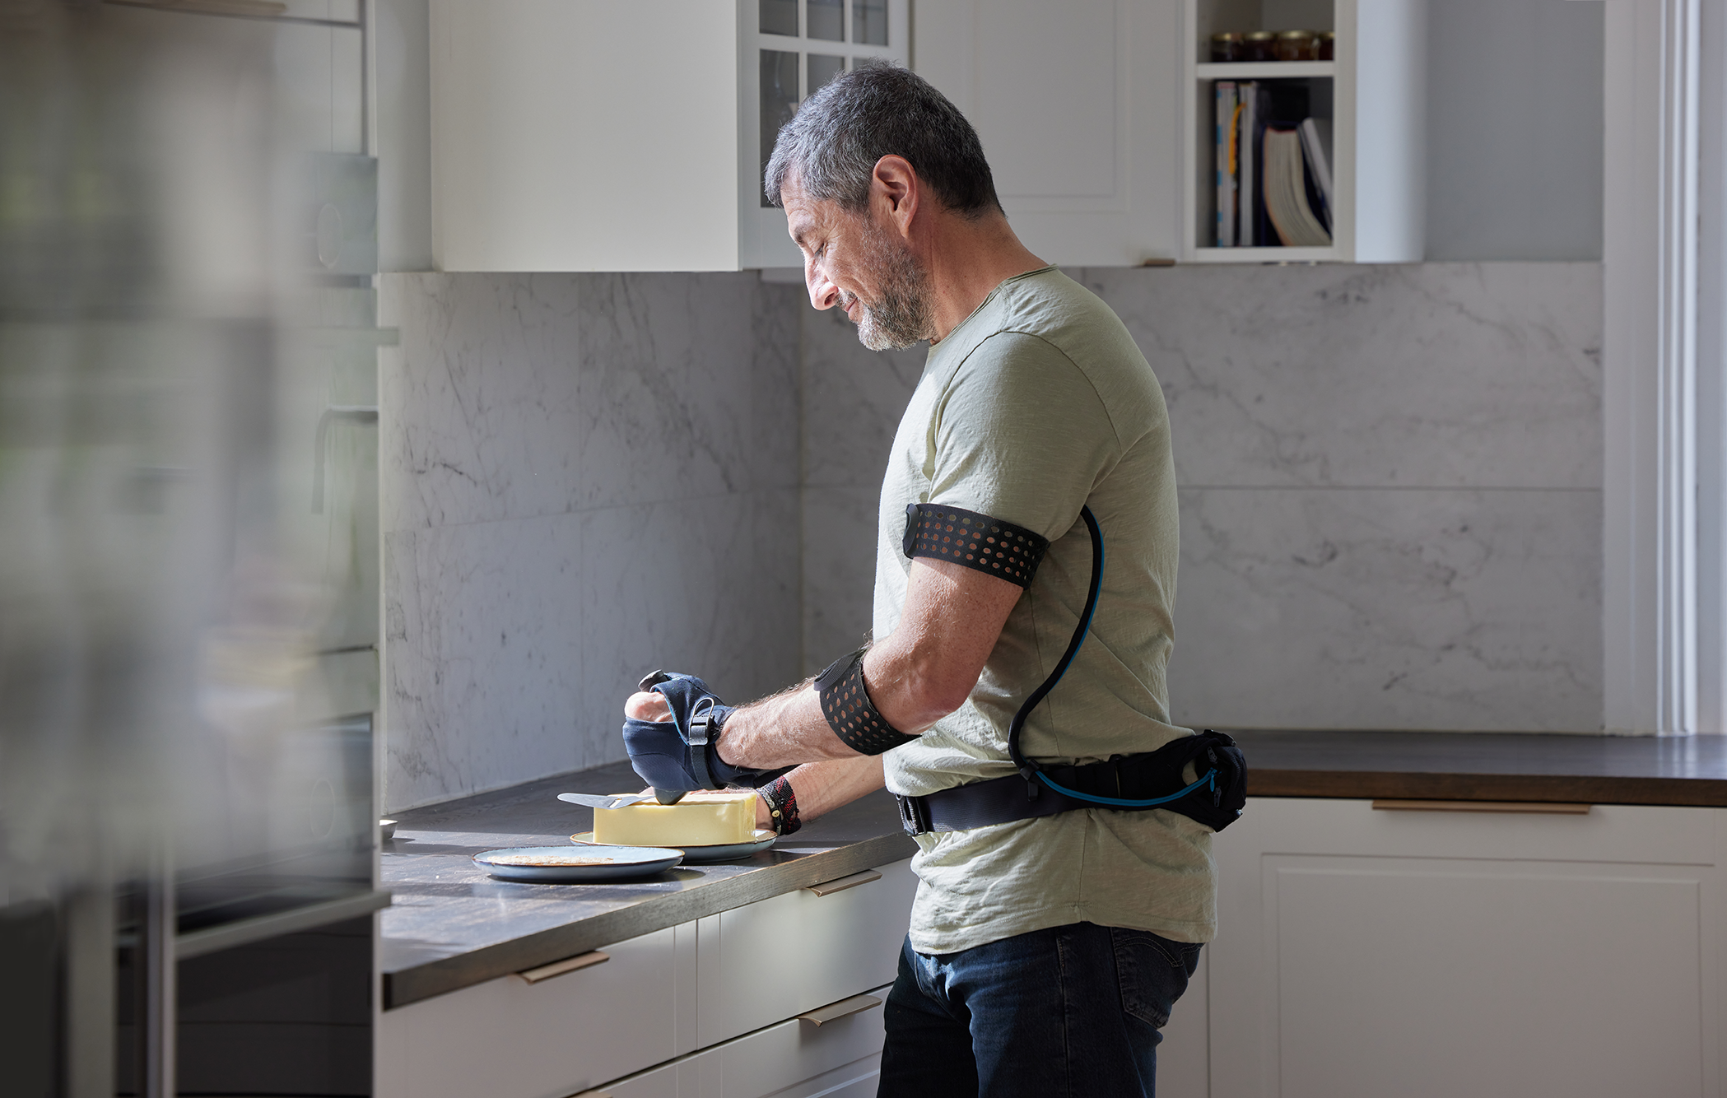
Center of Excellence
- Overview

Slide 2
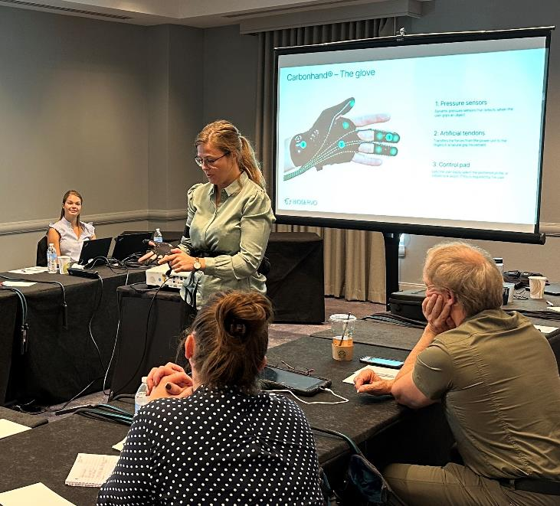
Carbonhand Center of Excellence Program
Bioservo's exclusive program equips clinicians at selected V.A. Centers to identify, onboard, and support successful integration of the Carbonhand into daily use.
The Center of Excellence program includes:
  Product training
  Clinical training
  Peer-to-peer consultations
  Ongoing clinical support
  Demo kit provided for clinic use

Slide 3
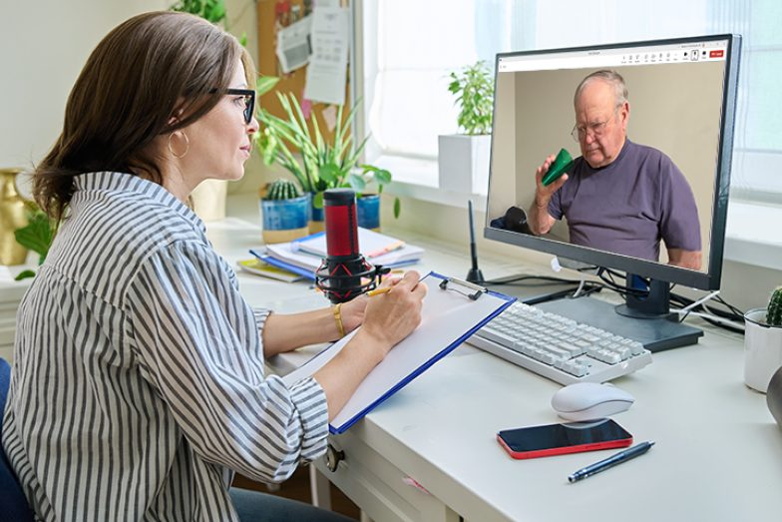
As a participant in the Center of Excellence Program, practitioners will be able to:
Identify appropriate candidates for Carbonhand
Perform clinical assessments and patient fittings
Provide onboarding assistance and device configurations
Support successful integration to promote greater independence with daily activities
Join a unique community of Carbonhand Specialists

Slide 4
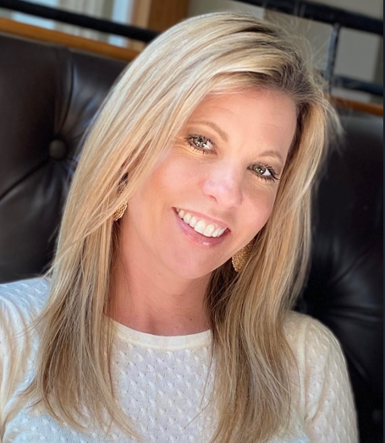
Online Peer-to-Peer Training
We offer expert-led, peer-to-peer training through our Center of Excellence program
Heidi Hoffman, OTR/L
Lead Clinical Specialist

Slide 5
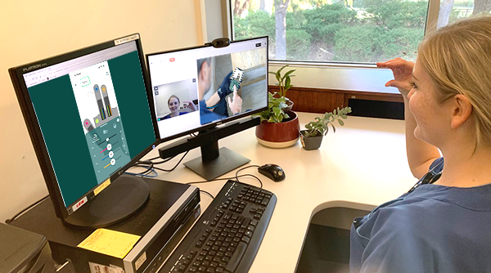
Assessment Support
We offer remote support to help your clinical team feel confident during initial trials.
During a Teams/Zoom session, we can connect to the patient’s Carbonhand and adjust settings to ensure the best user experience.
This same approach can be used for future patient follow-up support.

Slide 6
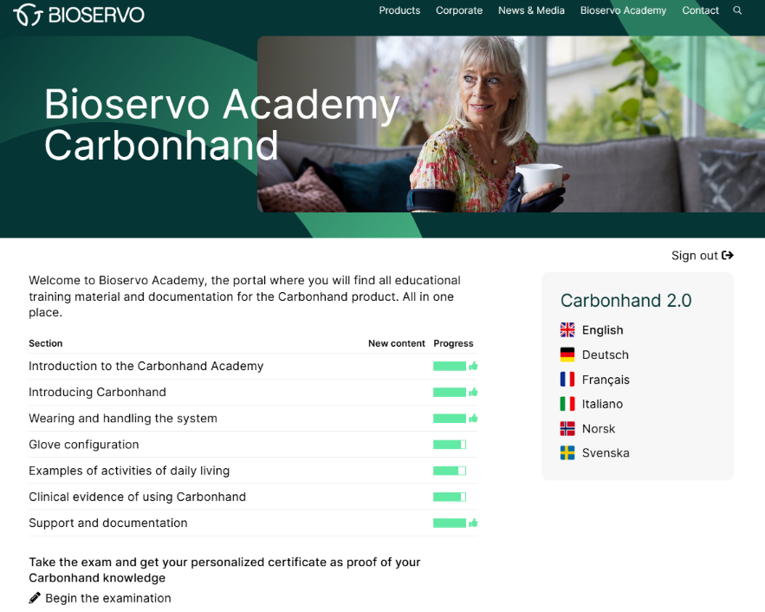
Carbonhand Academy – Extended Online Training for Clinicians and Users
*Completion recommended prior to Center of Excellence training*
The Academy covers:
Safe and effective Carbonhand use
Personalizing system settings
Daily activities supported by Carbonhand
Clinical evidence
Format: Short, self-paced video modules
(total time: ~1 hour)
*Certificate provided upon successful completion of the exam*

Slide 7
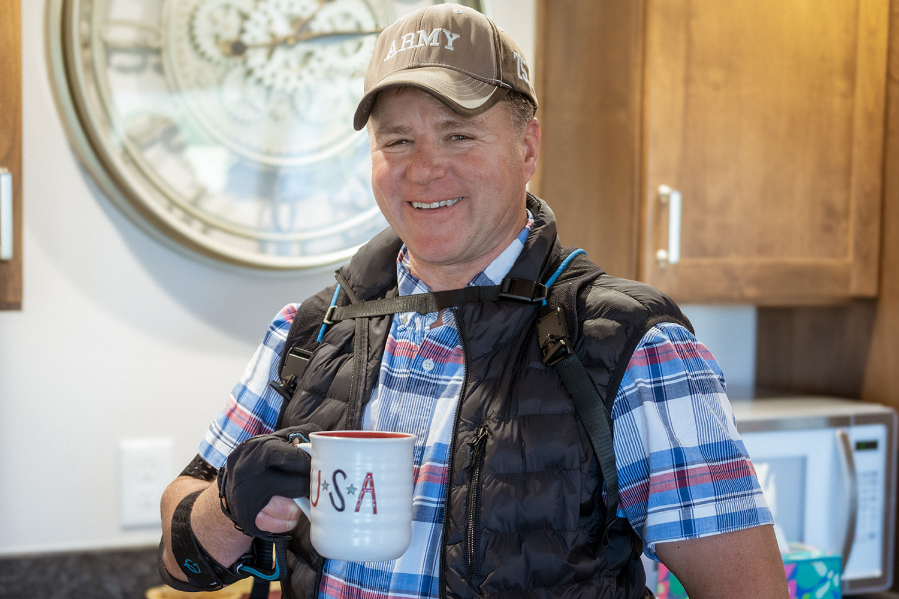
Program requirements
Before a facility can participate in the Center of Excellence Program, the following requirements should be completed. Having this foundation in place ensures that the training is relevant, practical, and builds on real clinical experience with Carbonhand.
An in-service and patient trial have been conducted with the clinic.
At least one Carbonhand has been prescribed, ordered,
and fitted before the Center of Excellence training is scheduled.
At least one participating clinician has observed a Carbonhand
representative complete the fitting of the clinic’s first
prescribed device.
A minimum of two clinicians participate in the
Center of Excellence training.
Once these requirements have been met and participation has been
confirmed, the Center of Excellence program can begin.

Slide 8
Center of Excellence Training
The training program includes:
Two virtual training sessions and a Clinical Demo Kit unboxing. A Carbonhand representative is on-site with the clinical team while a Carbonhand Clinical Specialist joins virtually. Each session is approximately 45–60 minutes. If preferred, the sessions may be combined into one longer training session.
Optional patient fitting during the training. Whenever possible, a suitable patient can be identified and pre-screened in advance, allowing the clinical team to immediately apply what they have learned in a real clinical setting. If an appropriate candidate is not available, the hands-on portion of the training can instead be completed with the participating clinicians.
A brief competency exam, completed together as a group at the end of the training.
Digital certificates of completion for each participating clinician.
A framed Center of Excellence facility certificate, mailed after training.
A comprehensive Center of Excellence resource binder containing step-by-step guides, clinical resources, reference materials, and tools to support implementation within the facility.

Slide 9
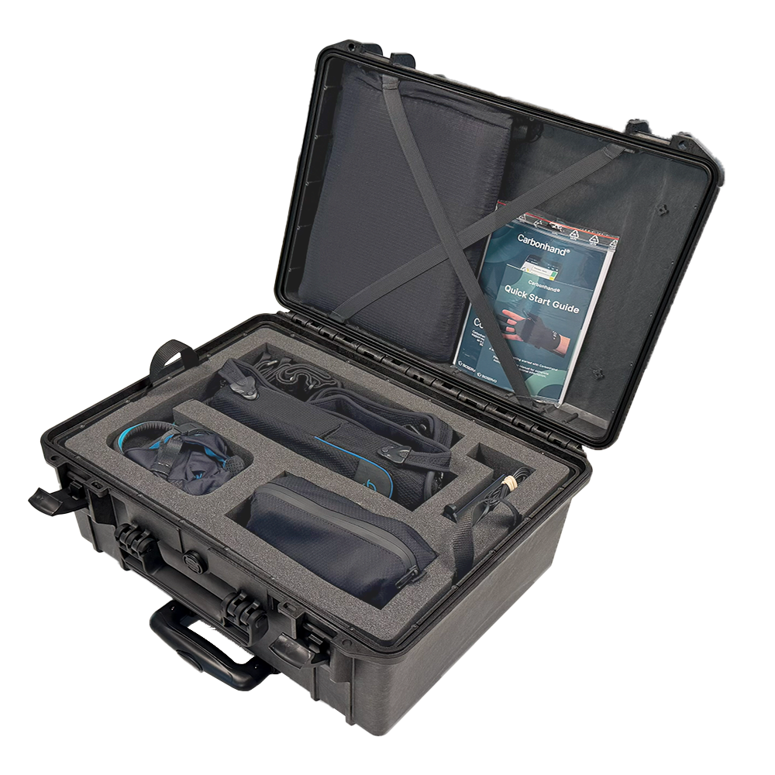
Clinical Demo Kit
Participating facilities receive a Carbonhand Clinical Demo Kit on an
initial 90-day loan. The kit remains at the facility and may be used for:
Patient screenings
Trials and evaluations
Staff training
Incorporating Carbonhand into patient treatment
when clinically appropriate.
At the end of the initial 90-day loan period, the facility and
the Carbonhand team will review the experience, discuss
ongoing needs and explore potential next steps.

Slide 10
Ongoing Support During the Loan Period
Center of Excellence facilities also receive monthly on-site check-ins from their Carbonhand representative during the 90-day loan period.
These visits are an opportunity to support the clinical team and ensure that the demo kit remains ready for patient use. During each check-in, the Carbonhand representative will:
Review and install available firmware updates when appropriate
Reset glove profiles to their original demo settings
Confirm that the Clinical Demo Kit is complete, organized, and ready for use
Answer questions from the clinical team
Review recent patient trials or potential candidates
Provide additional guidance and support as needed

Slide 11
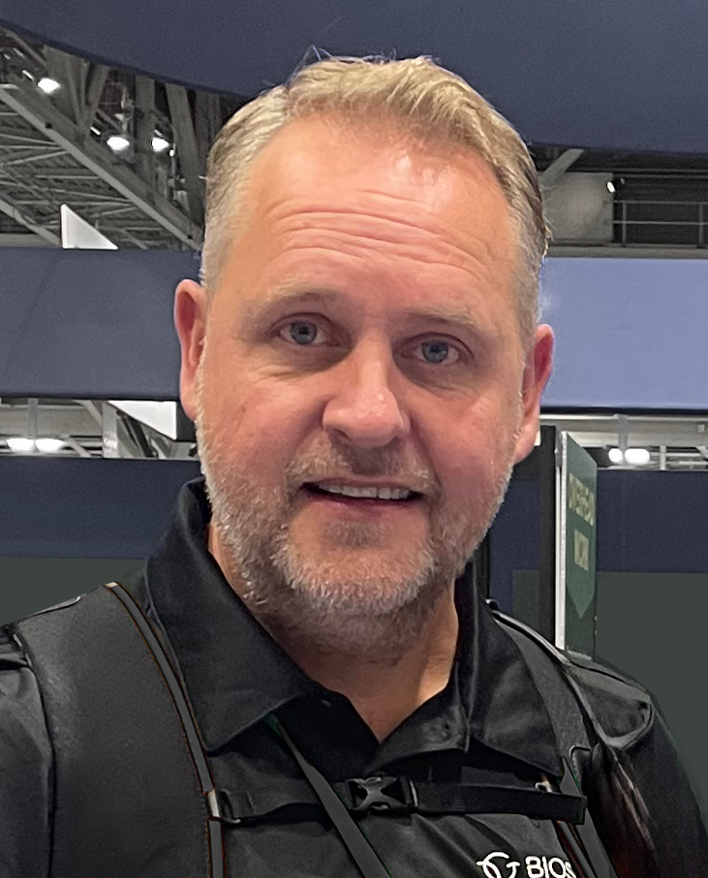
Your Support Team
Heidi Hoffman
Lead Clinical Specialist
Phone: 704-779-4040
Email: heidi.hoffman@bioservo.com
Fredrik Ostrom
VP U.S. Operations &
Veterans Affairs
Phone: 817-202-5048
Email: fredrik.ostrom@bioservo.com

