Slide 1
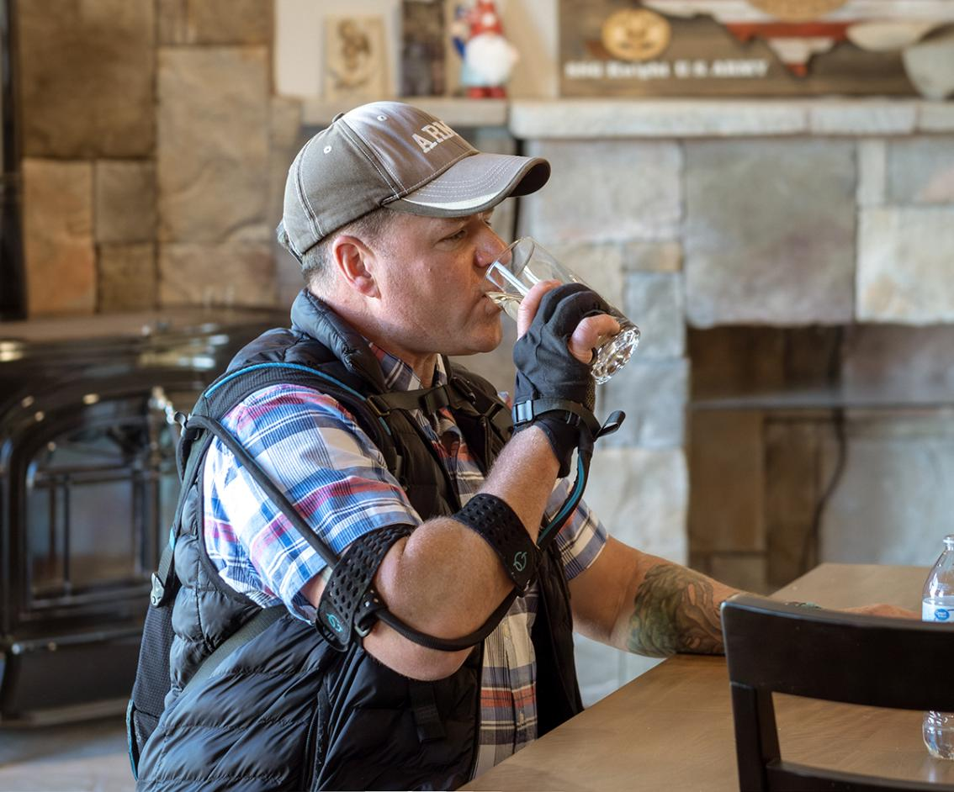
Empowering people with impaired hand function

Slide 2
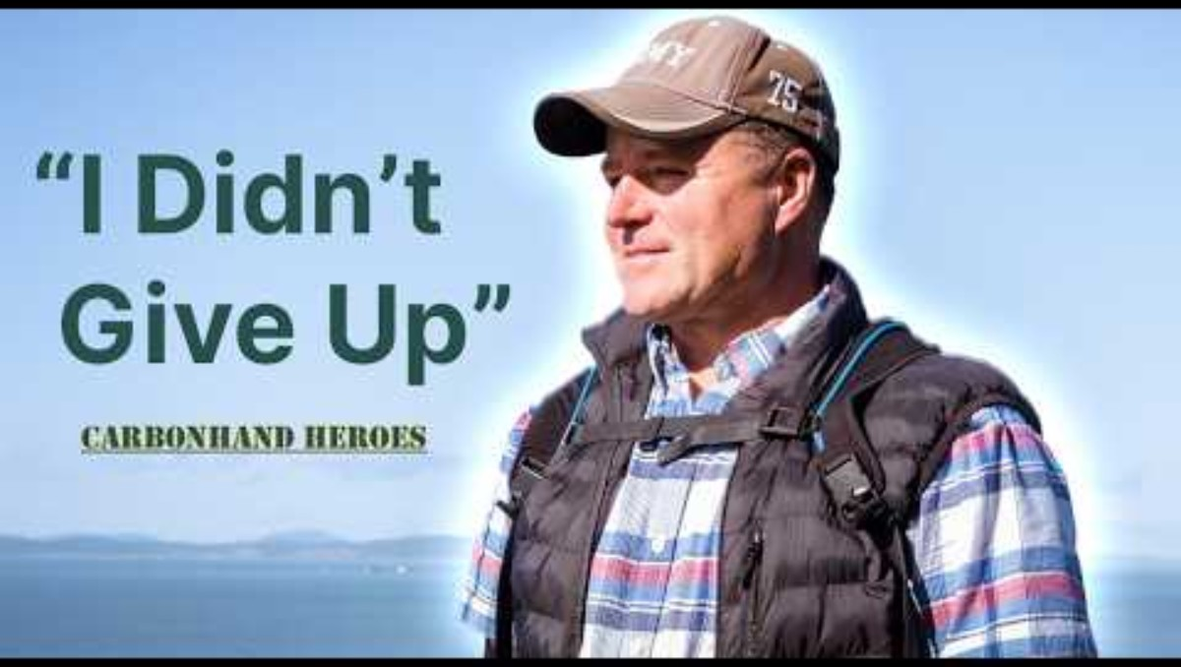
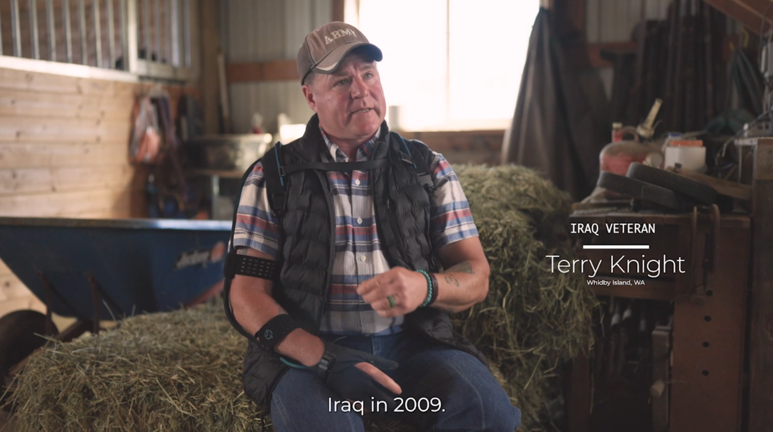
A Carbonhand® Hero
Notes:
This is what the user says....
.. What does the clinical studies say?

Slide 3


A Carbonhand® Hero
Notes:
This is what the user says....
.. What does the clinical studies say?

Slide 4



Our mission
We empower people with impaired hand function through innovative and lifechanging solutions.
We Increase independence, improve quality of life, and enable a new Standard of Care.

Slide 5
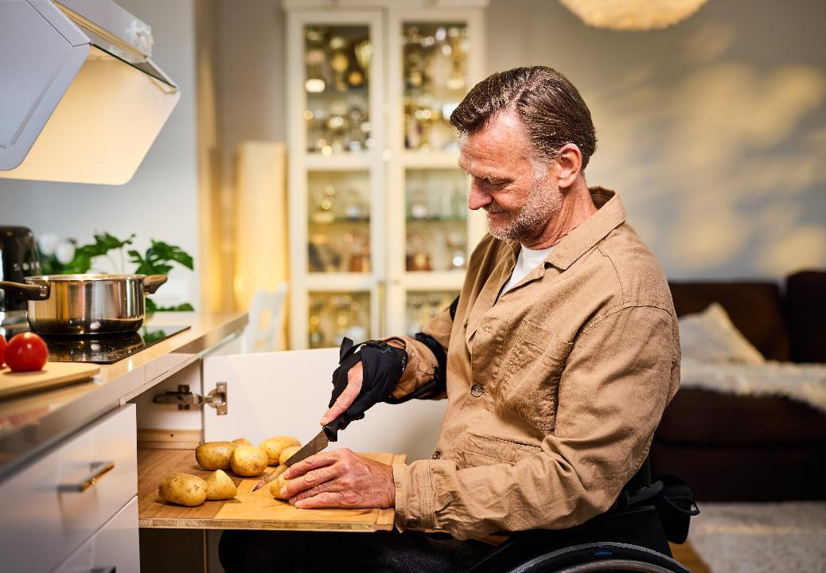
The Carbonhand® system
A 3-finger glove, with state-of-the-art technology using embedded pressure sensors to enhance grip
Artificial tendons control the force of each finger to improve grip response and strength
The Glove can be worn to suit different users and situations
An App allows for programming of multiple user profiles to fit all user needs and situations
Battery capacity to facilitate daily activities for a whole day
Carbonhand provides increased independence and quality of life for the user!

Slide 6
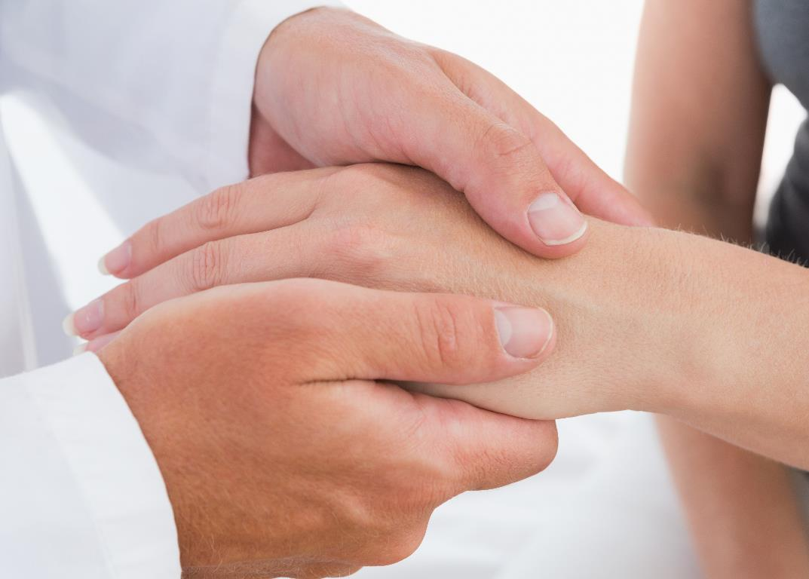
Who can benefit from using Carbonhand?
Indication for Use: People with reduced grip strength and/or impaired hand function.
Examples of patient groups:
Stroke | Stroke
Neurological Injuries | Spinal Cord Injury
 | Traumatic Brain Injury
 | Brachial Plexus Injury
 | Peripheral Nerve Injury
Neurological Illness | Amyotrophic Lateral Sclerosis
 | Multiple Sclerosis
 | Neuromuscular disorders
Age Related Weakness | Hand Osteoarthritis
 | Age related Sarcopenia
 | Rheumatoid Arthritis
Musculoskeletal disorders | Carpal Tunnel Syndrome
 | Epicondylitis
 | Other: Myositis
Notes:
In order to adjust to your country, calculate the first number by your country’s population x 11.375%
And the second number by multiplicating with 13%

Slide 7
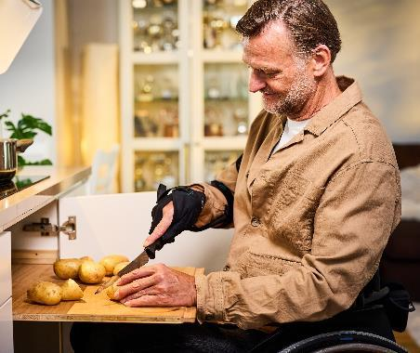
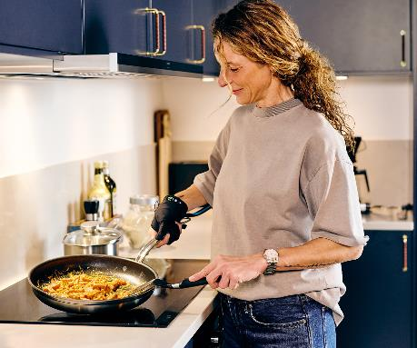
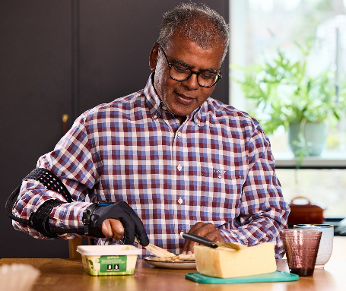
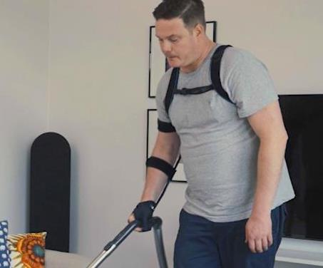
User examples
C
C
C
C
Peter
Spinal Cord Injury
Limited functionality in right hand
Carbonhand provides a firm grip and helps him during daily activities
Helen
Multiple Sclerosis (MS)
Weakness and a limited possibility to perform ADL
Carbonhand gives her better grip and endurance during activities of daily living
Scott
Post-traumatic hand injury
Reduced muscle function in the right hand
Carbonhand makes it possible for Scott to continue his active lifestyle.
Mats
Peripheral nerve injury
Impaired functionality of right hand
Carbonhand gives him a chance to continue to work and play with his kids
Improved grip strength, hand function, and quality of life!
Notes:
Carbonhand is intended for people with impaired hand function, not limited to different diagnosis, but here some examples of diagnosis.

Slide 8
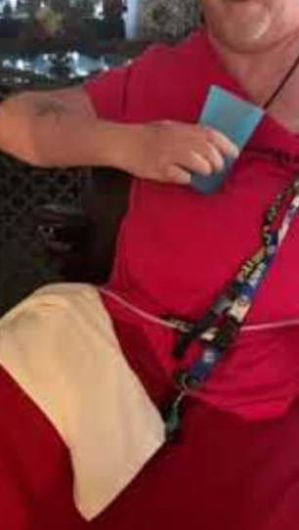
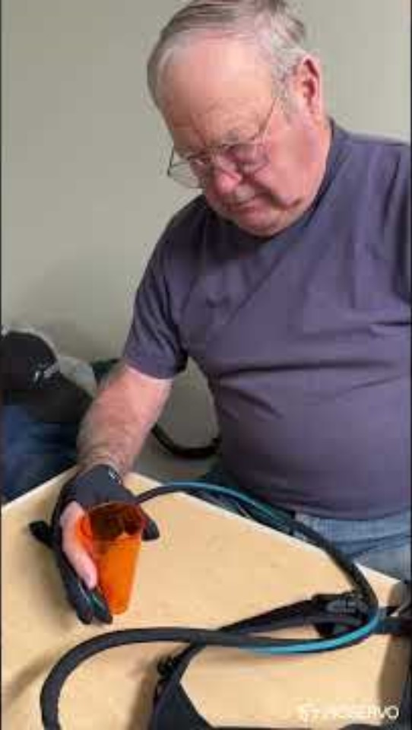
Real Life Examples
Bryan
Diagnosis:
Spinal Cord
Injury
Challenge:
Has a weak grip in his right hand and can’t hold objects
John
Diagnosis:
Inclusion Body Myositis
Challenge:
Has a weak grip and can’t hold objects

Slide 9
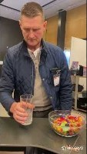
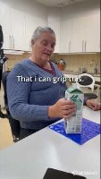
Real Life Examples
Daniel
Diagnosis:
ALS
Challenge:
Weak grip and
tremor
Ingrid
Diagnosis:
Multiple
Sclerosis
Challenge:
Weak grip

Slide 10
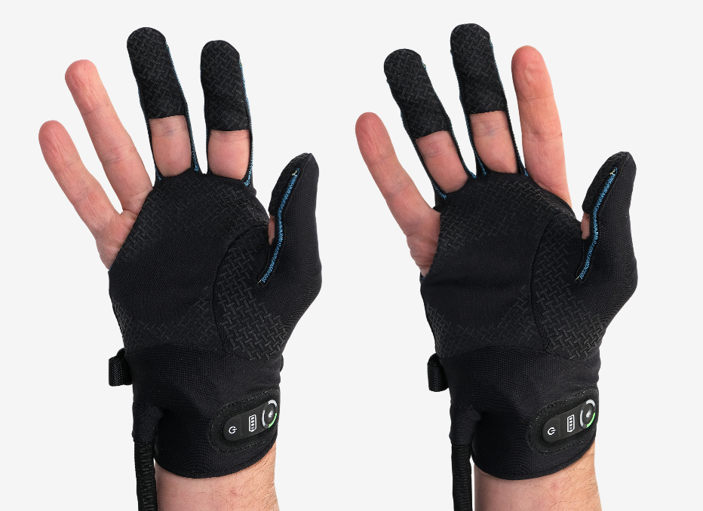
Two Wearing Options For Personalized Support
You can choose to select support for either the index and middle fingers, or the middle and ring fingers
Enables individuals with varying hand impairments to benefit from the glove
Wearing options allow flexibility to support different activities

Slide 11
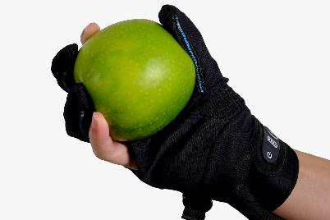
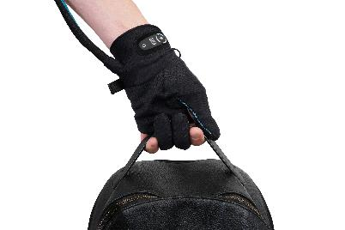
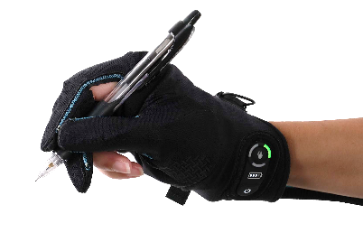
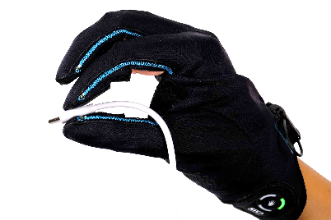
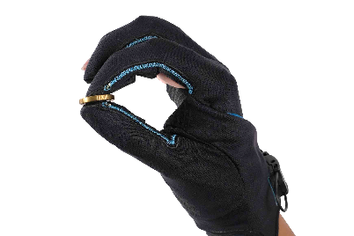
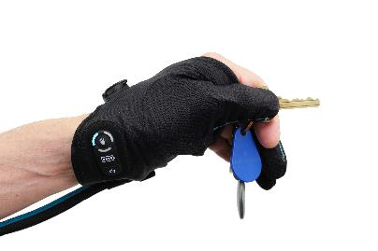
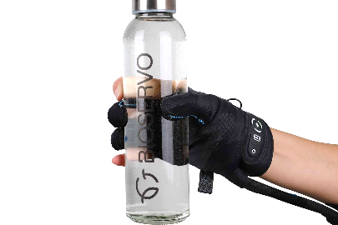
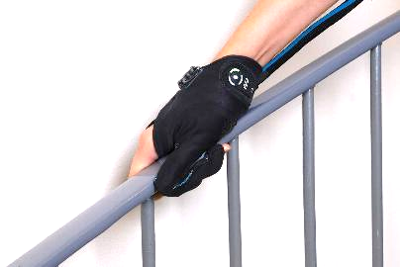
Supports Varying Functional Grip Patterns

Slide 12
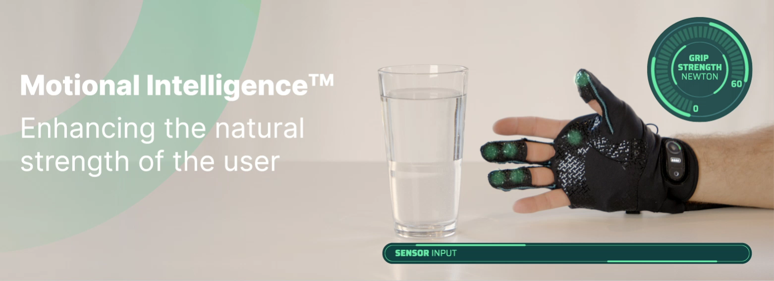
Carbonhand - how the system works
The sensors in the glove provide input when pressure is applied
The power from the motors is transferred through artificial tendons in the glove
The behavior of the glove is controlled by a sophisticated control system
The behavior can be customized for each individual user

Slide 13
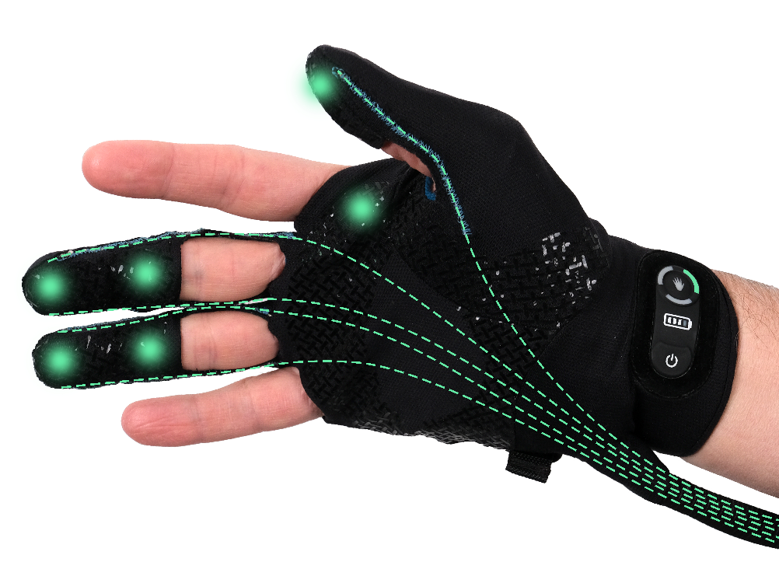
Carbonhand® – The Glove
1: Pressure sensors
Dynamic pressure sensors that detects when
the user grips an object
2: Artificial tendons
Transfers the forces from the power unit to the
fingers in a natural grip movement
1
3
2
3: Control pad
Let the user easily select the preferred profile or
initiate lock assist, if this is required by the user

Slide 14

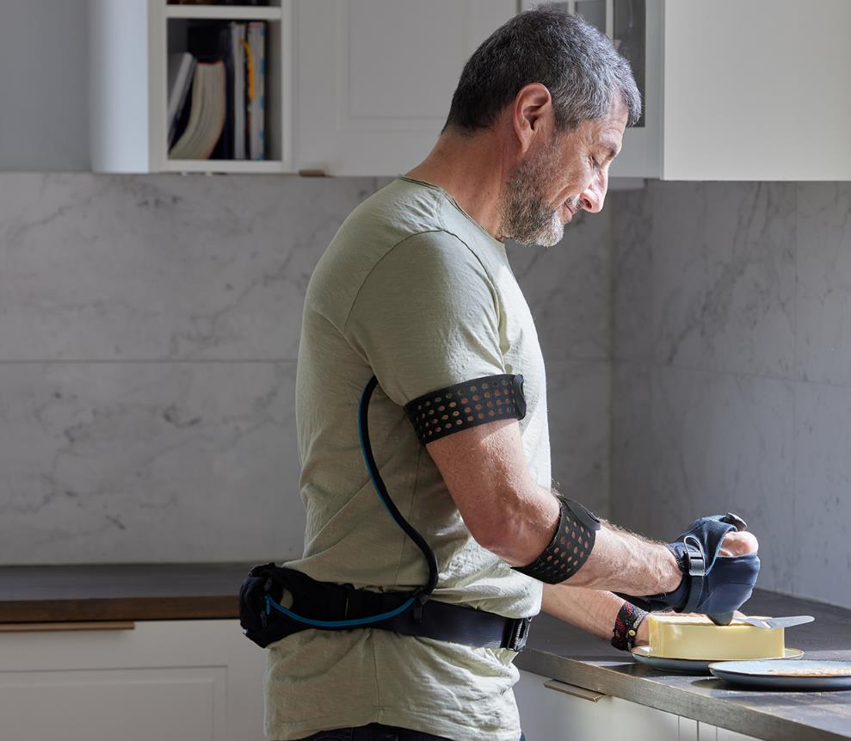
Carbonhand® – The system
1. Glove
Soft, lightweight, and flexible glove with pressure sensors,
artificial tendons, and control pad
2. Power unit
Includes battery (8 h), power actuators, control system
and glove connector
3. Cord
Contains electrical and bowden cables to transfer sensor
signals and forces between the glove and power unit
4
3
4. Arm straps
Keeps the cord close to the user in order to avoid
entanglement
4
1
2

Slide 15
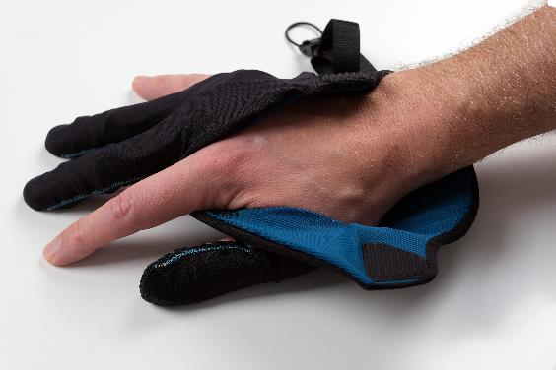
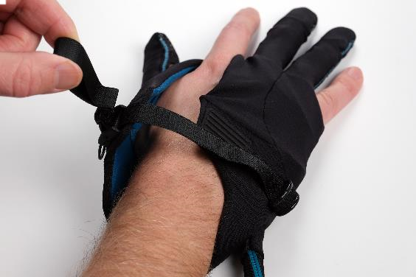
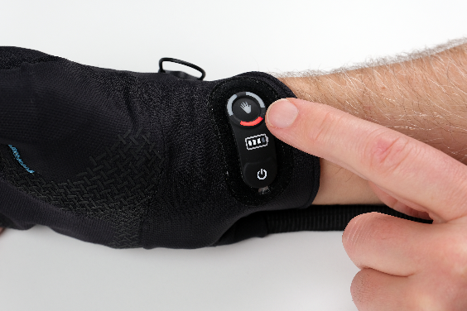
Ease of use
Open design
And made of flexible material
to fit different anatomies and
impaired hand function
C
Magnetic buckle
Makes it easy to don and
doff the glove
Control pad
Allows selection of user profiles, initiate lock assist, or calibration
C
C

Slide 16
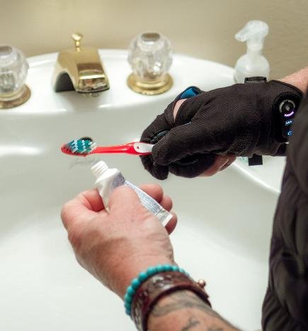
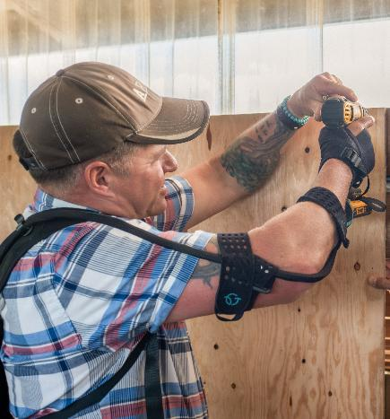
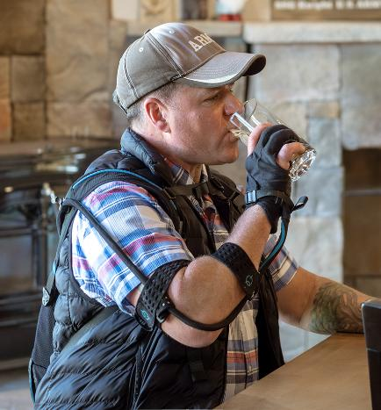
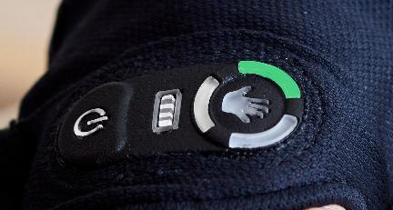
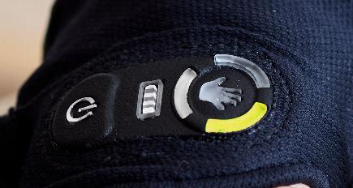
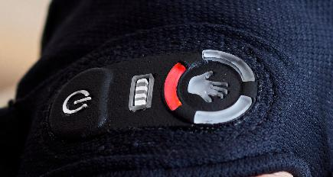
Adaptable Anywhere, Ready Anytime
Three User Profiles
Each profile offers different settings based on the user's support needs and can be easily adjusted on the control pad.
Further customization and additional profiles are available through the Bioservo App.
Precision Task Dynamic Strong & Steady

Slide 17
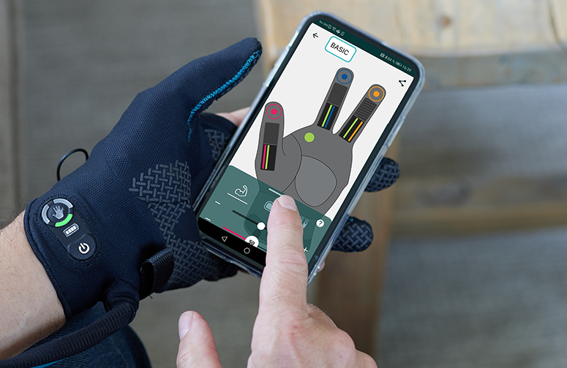




Bioservo App – Personalized setting of functionality
Carbonhand comes with three pre-defined profiles, that can be personally adjusted to fit the user’s needs:
Max force
The maximum force provided by Carbonhand
Stickiness
The force required by the user to release the grip
Responsiveness
The speed between sensor input and force output
Sensor synergies
Linking sensors to multiple fingers

Slide 18
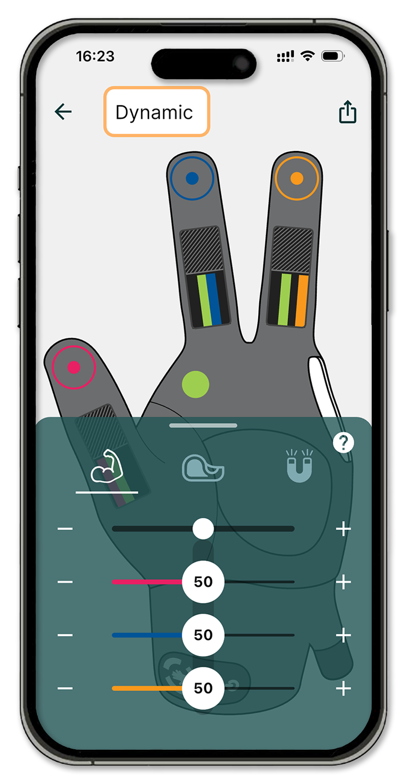
Max Force
Decides how much force is applied by Carbonhand.
Can be adjusted for each finger individually to compensate for impairments in specific fingers, or combined if needed equally for all fingers.
Create specific profiles tailored to your activities and timing, for example, less Max Force in the morning and more in the evening.
594bae24-2762-4511-bde4-4d396f89f6c5
Notes:
The 1st setting is max force. Simply put, this is the amount of force the carbonhand will provide once the sensors have been activated. The higher the force setting, the stronger the grip the glove will provide. The force is represented by the muscle icon you see here. Now, you can either adjust all fingers together indicated by the black bar at the top, or adjust them individually. You also have a visual representation of the force in the fingers themselves by how high the lines are. If you need a reminder of what the setting does, you can press the ? Icon for a descripton

Slide 19
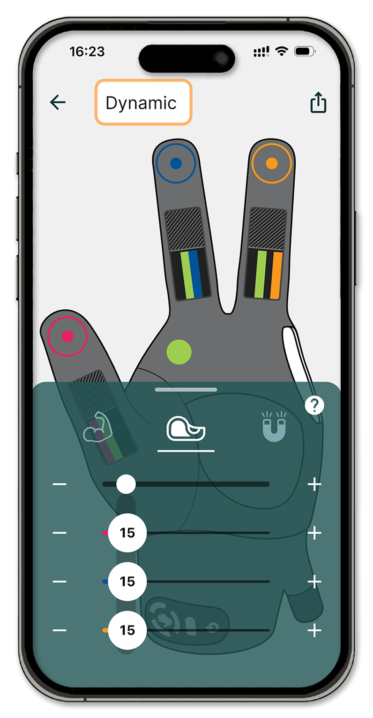
Stickiness
The stickiness helps the user to hold on to objects, but requires more effort to release grip
At the maximum setting, Carbonhand provides maximum holding stability
Consider low stickiness setting in patients with weak finger extension
The grip can also be completely locked by activating the Lock Assist function from the Control Pad
Notes:
The stickiness setting controls how firmly the glove maintains a grip once activated. Higher stickiness improves stability and prevents objects from slipping but can make it harder to release. For patients with weak finger extension, a lower setting is recommended to make letting go easier. So for example if a patient has poor grip endurance, a higher stickiness setting may be ideal. However, if a patient has difficulty letting go of an object or weak finger extensors, a lower stickiness setting would be better. The stickiness symbol is the tape icon. And the visual representation is how large the fingertip dot is

Slide 20
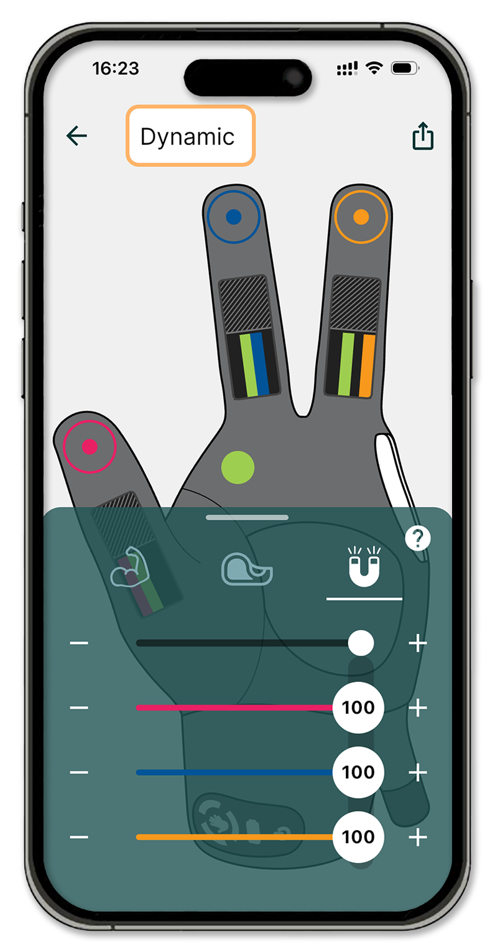
Responsiveness
Users can adjust how quickly the system responds once a sensor is activated
An increased responsiveness provides a “magnetic” feeling
Assists individuals with decreased grip strength to initiate a grip
Notes:
The responsiveness setting indicated by the magnet icon, determines how quickly the glove will react once a sensor has been activated. If performing more dynamic tasks such as folding laundry, or opening jars, a higher responsiveness setting should be considered. Visual representation is how thick the lines are

Slide 21
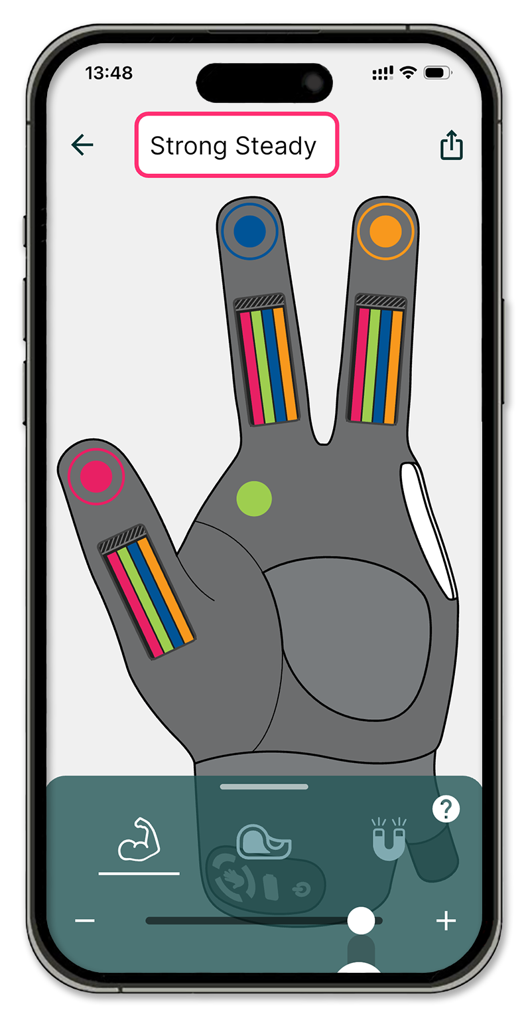
Linking fingers
Sensors on one finger can be linked to another finger in order to activate also that finger
The palm sensor can be used to activate any finger or fingers
This is useful when the user has difficulties initiating a grip
Notes:
Example:
If a user holds on to an object, one of the fingers will get more power than the others. Without the Grasp Stabilizer, the sensor on one of the other fingers would notice a pressure drop and reduce the force. The user would compensate by pressing harder on that finger, and the system would notice a pressure drop on the first finger, reducing the force on the first finger. Etc.
This would create a “Wobbling” effect

Slide 22
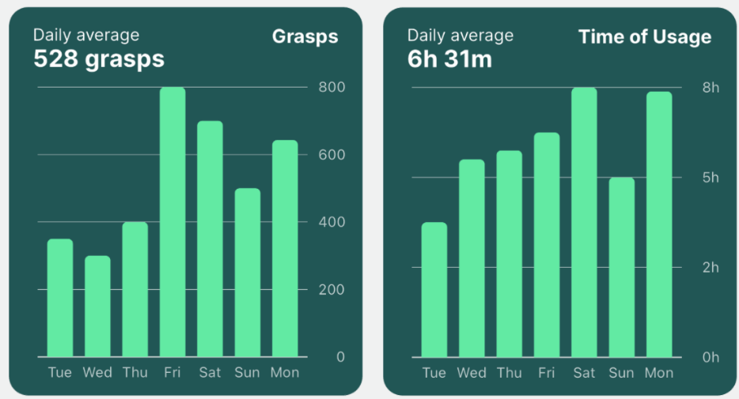
My Activity - Reporting in the APP
Motivational monitoring and tracking
Analyze trends and Track activity
View the information for one day, one week, three months or one year
Swipe back and forth in time to see how patterns of use differ.

Slide 23
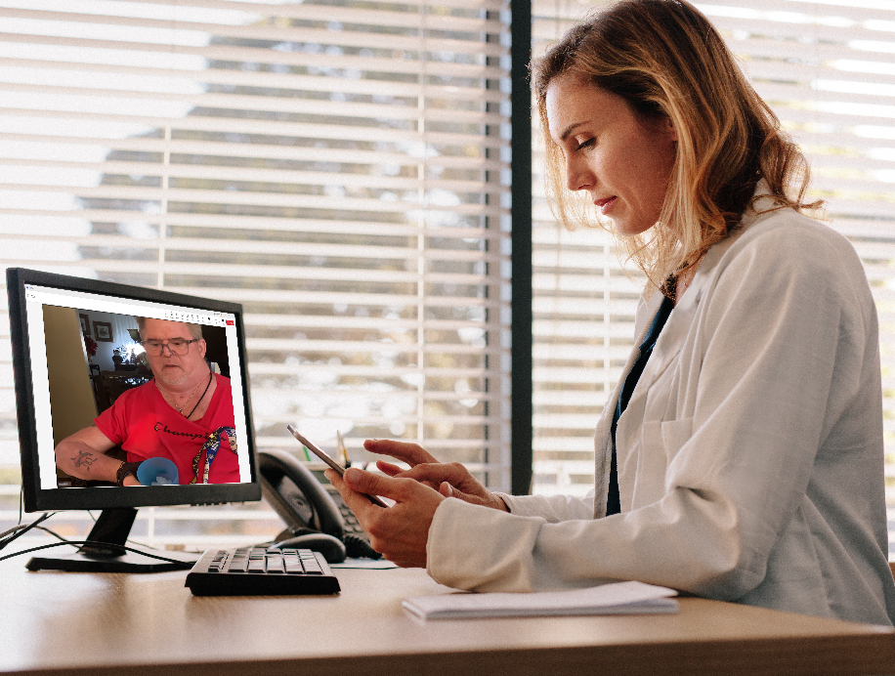
Remote Connectivity
Allows clinician or Carbonhand representative to securely log into a patient’s Bioservo APP remotely
Allows remote configuration of glove
  Add or adjust grip profiles
  Troubleshoot
Enables clinicians to access grip reporting

Slide 24
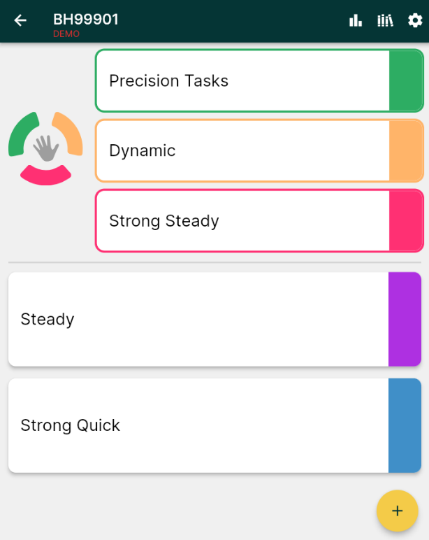
The Bioservo App – Web Demonstration
https://app.bioservo.cloud/

Slide 25
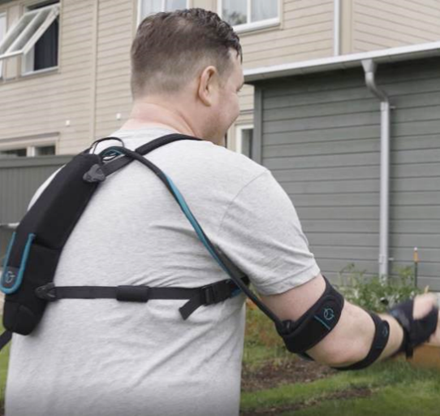
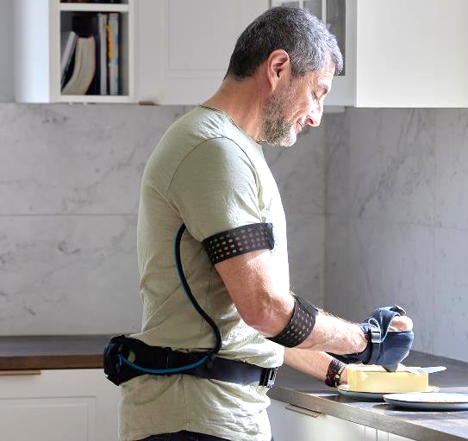
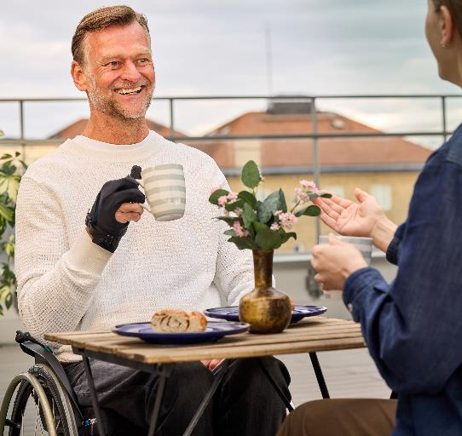
Several Carrying Options
Carbonhand can be carried in multiple ways, with a foldable design for carrying in a bag, purse, or mounted on a wheelchair

Slide 26
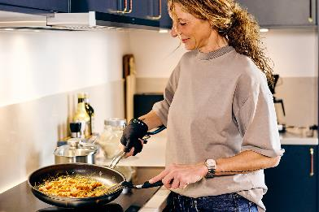
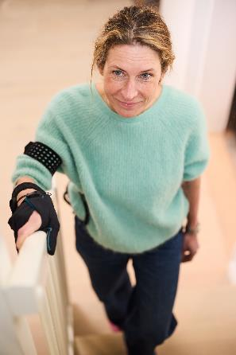
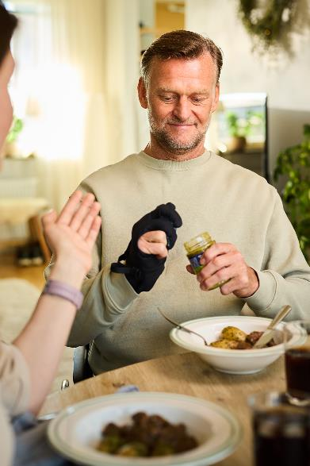
Evidence on Carbonhand as an Assistive Device
In total 367 patients were included in the trials showing the effect of using Carbonhand. People with reduced grip strength and/or impaired hand function due to various reasons and diagnoses were included as study participants. For example; people with Stroke, Spinal Cord Injury, Multiple Sclerosis, Sarcopenia, and Myopathy benefited from using Carbonhand within these trials.
The results show that:
Manipulation of several objects encountered in ADL was
experienced as improved during the use of Carbonhand
A sustained and strong grip was perceived as the
most beneficial effect while using Carbonhand
The participants experienced an improved grip strength
during the use of Carbonhand
The usability of Carbonhand was rated as high
Carbonhand is safe to use.
The medical claim based on these studies:
Carbonhand enhances the user’s ability to perform activities in daily living.
Notes:
No serious adverse events were reported during these trials. Carbonhand is safe to use.

Slide 27
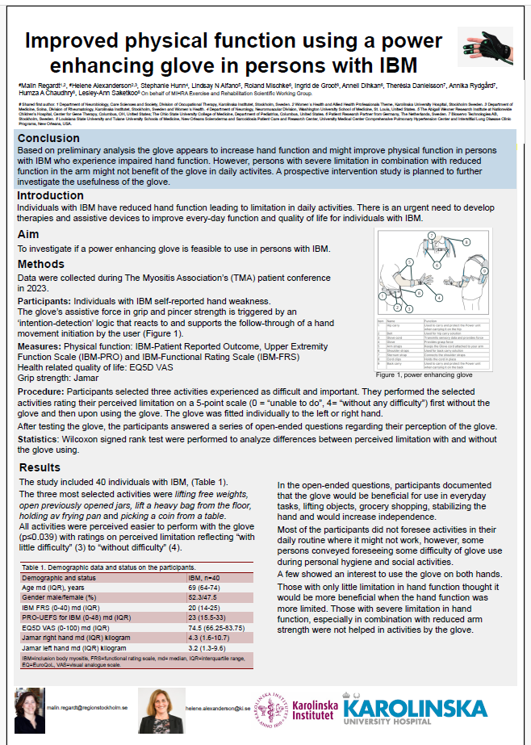
Usability Trial - Carbonhand an Assistive Device
Presented at Global Conference on Myositis in Pittsburgh, USA
March 2024
Table 2. Measures on difficulty in chosen activities without and with the glove, ​ (0 = "unable to do", 4 = "without any difficulty"). ​
Chosen activity​ | Without the glove​ | With the glove​ | ​
Lift free weights, n=16​ | 2 (1-2)​ | 4 (3.25-4)​ | ​
Open previously open jars, n=16​ | 1 (1-2)​ | 4 (3-4)​ | ​
Lift a heavy bag from the floor, n=15​ | 2 (2-2)​ | 4 (4-4)​ | ​
Hold a frying pan, n=11​ | 1 (1-2)​ | 3 (3-4)​ | ​
Pick a coin from a table, n=8​ | 2 (1.3-3)​ | 3.5 (2.3-4.0)​ | ​
Notes:
In 2023 a usability trial was conducted in collaboration with the Karolinska Institute in stockholm, Louisiana State University and Tulane University Schools of Medicine, Washington University School of Medicine, Ohio State College of Medicine.
Data were collected during The Myositis Association’s (TMA) patient conference in September 2023.
40 patients with reduced grip strength and self-perceived impaired hand function due to the rare disease Inclusion Body Myositis were included.
Participants selected three ADL activities experienced as difficult and important. They performed the selected activities rating their perceived limitation on a 5-point scale (0 = “unable to do”, 4= “without any difficulty”) first without the glove and then upon using the glove. The glove was fitted individually to the left or right hand.
After testing the glove, the participants answered a series of open-ended questions regarding their perception of the glove.
Wilcoxon signed rank test were performed to analyze differences between perceived limitation with and without the glove using.
The table shows the results of the most selected activities. The most selected activities were lifting free weights, open previously opened jars, lift a heavy bag from the floor, holding av frying pan and picking a coin from a table. As you can see these tasks require force, muscle endurance and fine motoric skills.
In the open-ended questions, participants documented that the glove would be beneficial for use in everyday tasks, lifting objects, grocery shopping, stabilizing the hand and would increase independence. Most of the participants did not foresee activities in their daily routine where it might not work, however, some persons conveyed foreseeing some difficulty of glove use during personal hygiene and social activities.
A few showed an interest to use the glove on both hands.

Slide 28
References for Carbonhand as an Assistive Device
Radder B, Prange-Lasonder G, Kottink A, Melendez-Calderon A, Buurke J, Rietman J. Feasibility of a wearable soft-robotic glove to support impaired hand function in stroke patients. J Rehabil Med 2018; 50: 598–606.
Radder B, Prange-Lasonder G, Kottink A, Holmberg J, Sletta K, Van Dijk M, Meyer T et al. (2018): The effect of a wearable soft-robotic glove on motor function and functional performance of older adults, Assistive Technology, DOI: 10.1080/10400435.2018.1453888
Osuagwu B.A. et al. (2019) Clinical Trial of the Soft Extra Muscle Glove to Assess Orthotic and Long-Term Functional Gain Following Chronic Incomplete Tetraplegia: Preliminary Functional Results. In: Masia L., Micera S., Akay M., Pons J. (eds) Converging Clinical and Engineering Research on Neurorehabilitation III. ICNR 2018. Pp 385-389. doi.org/10.1007/978-3-030-01845-0_77
Nilsson M, Fryxell W. A, Wadell C, von Holst H, Borg J. A Helping Hand – On Innovations for Rehabilitation and Assistive Technology. Grip strengthening glove to improve hand function in patients with neuromuscular disorders. Doctoral Theisis. Stockholm: Royal Institute of Technology; 2013. ISBN 978-91-7501-703-7
Hermansson L, Gunnarsson M, Lutterman M. Effect of a grip-strengthening glove on persons with reduced hand function. (2014).
Palmcrantz S, Plantin J, Borg J. Factors affecting the usability of an assistive soft robotic glove after stroke or multiple sclerosis. Karolinska Institutet, Department of Clinical Sciences, Danderyd Hospital, Division of Rehabilitation Medicine, Stockholm, Sweden. Journal of Rehabilitation Medicine (2020). https://doi.org/10.2340/16501977-2650
Hashida R, Matsuse H, Totsugi M, Omoto M, Shinozaki N, Tanaka J, Nago T. (2016). Study on the Effects of Motor-Assisted Gloves (SEM™ Glove) on Functional Disorders of the hand. The Kurume Medical Journal (2018). DOI:10.2739/kurumemedj.MS652007
Radder B, Prange-Lasonder GB, Kottink AIR, Holmberg J, Sletta K, Van Dijk M, et al. The effect of a wearable soft-robotic glove on motor function and functional performance of older adults. Assist Technol. 2020;32(1):9–15
Notes:
Hur får jag samma radavstånd mellan punkt 7 och 8?

Slide 29

Clinicians: Education and Support
Carbonhand Academy with Step-by-step video tutorials
Exam for Carbonhand Certification
A Center of Excellence program is available including:
  Product Training
  Clinical Training
  Peer-to-peer Consultations
  Support

Slide 31
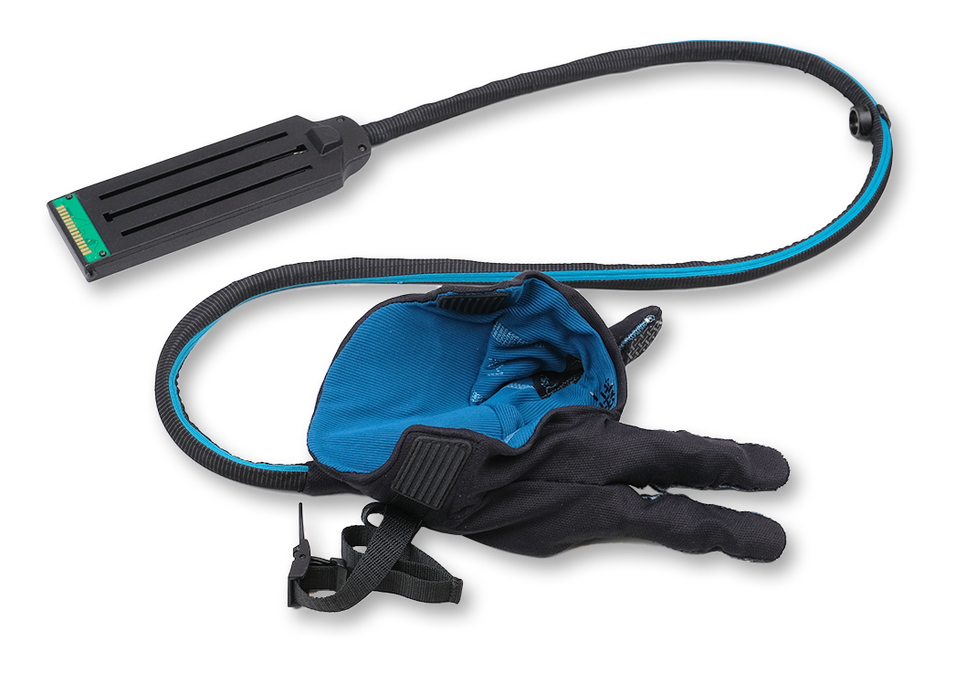





Carbonhand – The Components 1/2
Glove with Glove Connector
Power Unit
Shoulder Straps
Arm straps (3)
2-S/M 1-L
Power Unit Sleeve
(Single or Double Carry)
Belt
(S/L, Med=S+L)
Notes:
Here are the individual components prior to assembly. What I love about the Carbonhand is the functionality and portability it provides without large, heavy and bulky components. Here we have the glove, which is attached to the cord and the glove connector which attaches to the power unit. The PU is kept in the sleeve. Here you have the shoulder straps if the patient will be wearing it on their back, and the belt for the waist. Lastly you have the arm straps which secures the cord to the patient. *DOUBLE CARRY SYSTEM* *WC strps*

Slide 32





Carbonhand – The Components 2/2
Charger
Soft Case
Padded Washing bag
External Button
(optional)
Wheelchair Attachment Straps
(optional)
Notes:
External button is sold seperately- basically a manual trigger switch that when pressed, the glove is activated for gripping. This will make more sense later as I discuss all the components In more detail. But basically if the patient is unable to activate the sensors in order to facilitate a grip, the button can trigger the grip and release it as well.

Slide 33


Power transmission
Ball screws
Transfers the rotation from the electrical motors to a linear movement.
Artificial tendons
in the glove connection are pulled with a maximum force of 20 N each.

Slide 34
Carbonhand®

